Slide 1
Zπ
Zπ MATHS HUB
Pearson Edexcel IGCSE (9–1) · Higher Tier
Cumulative Frequency
Running Totals · Plotting the Curve · Median, Quartiles & IQR from the Graph
Zahra Sheikh Ali
IGCSE Mathematics Teacher · M.Sc. Differential Geometry & Geometric Control
☎ 66613748 ✉ zahraa.sheikhali@outlook.com

Slide 2
Zπ
LESSON OVERVIEW
Adding Up the Frequencies as You Go
Cumulative frequency is a RUNNING TOTAL of the frequencies. Plotting it gives an S-shaped curve you can read the median and quartiles from.
What cumulative frequency is
Working out the running total
Plotting the curve
1
2
3
Median & quartiles from the graph
The interquartile range
Past-paper questions
4
5
6
Key words: cumulative frequency · running total · ogive · median · quartiles · IQR · upper boundary

Slide 3
Zπ
THE KEY IDEA
Cumulative Frequency = Running Total
Keep adding on the next frequency — ‘how many so far’.
Height h (cm)
Freq
Cumulative freq
How the total builds
0 < h ≤ 10
4
4
4 → 4+9 = 13 → 13+15 = 28 → 28+12 = 40
The last total = the number of items (40).
10 < h ≤ 20
9
13
20 < h ≤ 30
15
28
30 < h ≤ 40
12
40
Each cumulative frequency = the one above it + the next frequency.

Slide 4

Zπ
PLOTTING THE CURVE
Plot at the UPPER Class Boundary
Plot each cumulative frequency at the TOP end of its class, then join the points with a smooth curve.
100
Two rules for plotting
90
Plot at the UPPER boundary of each class (10, 20, 30, 40 …).
80
Cumulative frequency goes up the vertical axis.
70
Start the curve on the horizontal axis (0 so far).
Join the points with a smooth curve — not straight lines.
60
Cumulative frequency
50
Time in seconds | Cumulative frequency
0 < t ≤ 35 | 9
0 < t ≤ 40 | 21
0 < t ≤ 45 | 45
0 < t ≤ 50 | 73
0 < t ≤ 55 | 89
0 < t ≤ 60 | 100
40
30
20
10
0
30
35
40
45
50
55
60
Time in seconds
Always plot each point at the TOP value of its class — never the midpoint.

Slide 5
Zπ
READING THE GRAPH
Median, Quartiles & IQR
Go across from the cumulative-frequency axis to the curve, then straight down. For n = 40:
Where to read across
Lower quartile: n÷4 = 10
Median: n÷2 = 20
Upper quartile: 3n÷4 = 30
IQR = UQ − LQ
the spread of the middle half of the data.
LQ
median
UQ
Median at n÷2, LQ at n÷4, UQ at 3n÷4; IQR = UQ − LQ.

Slide 6
Zπ
PART 2
Past-Paper Questions
Each question comes with its cumulative-frequency graph — read n÷2, n÷4 and 3n÷4.
1
Cumulative freq = running total
2
Plot at the UPPER boundary
3
Median n÷2, LQ n÷4, UQ 3n÷4
4
IQR = UQ − LQ

Slide 7
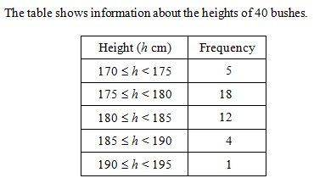
Zπ
PAST-PAPER QUESTION
Question 1
Height (h cm) | Cumulative Frequency
170 ≤ h < 175
170 ≤ h < 180
170 ≤ h < 185
170 ≤ h < 190
170 ≤ h < 195

Slide 8
Zπ
PAST-PAPER QUESTION
Question 2
60
IQR = UQ – LQ
= 38 – 21
= 17
50
¾
Cumulative Frequency
40
½
30
20
¼
10
Median = 27
LQ = 21
UQ = 38
0
10
20
30
40
50
60
70
Minutes Late
Get an estimate for the median.
Find the lower quartile.
Find the Upper Quartile.
Find the Inter Quartile Range.(IQR = UQ - LQ)

Slide 9
Zπ
PAST-PAPER QUESTION
Question 3
70
The graph shows the cumulative frequency curve of the marks for students in an examination. Use the graph to find:
(a) The median mark.
(b) The number of students who got less than 55 marks.
(c) The pass mark if ¾ of the students passed the test.
58
60
50
40
Cumulative Frequency
30
20
Median = 27
10
¾ of the students passing the test implies that ¼ failed. So read off from 15 students…
0
10
20
30
40
50
60
21
Marks

Slide 10
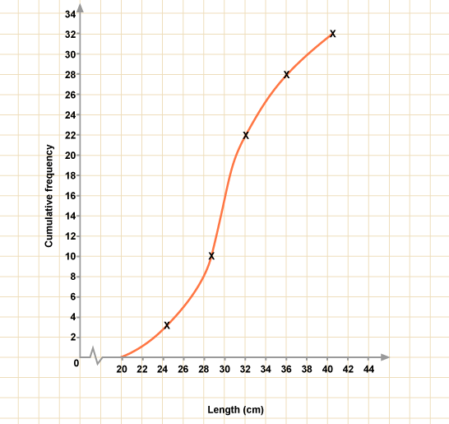
Zπ
PAST-PAPER QUESTION
Question 4
What is the total frequency?
At what frequency is the median value?
What frequency will the lower quartile be at?
What frequency will the upper quartile be at?
32
(½ of 32) 16
(¼ of 32) 8
(¾ of 32) 24

Slide 11
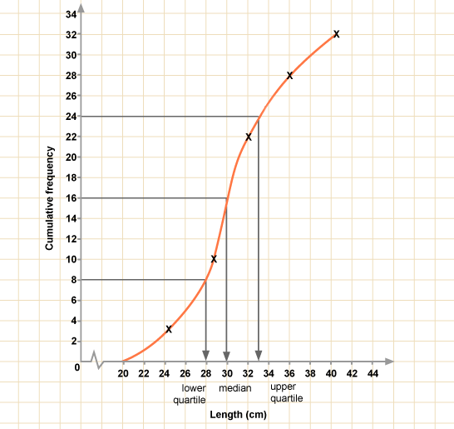
Zπ
PAST-PAPER QUESTION
Question 5
What is:
The shortest length and the longest length?
The median?
The lower quartile?
The upper quartile?
The inter-quartile range?
20 and 40
30
28
33
33 – 28 = 5

Slide 12
Zπ
PAST-PAPER QUESTION
Question 6
70
The cumulative frequency curve gives information on aircraft arriving late at an airport. Use the curve to find estimates to
(a) The median
(b) The inter-quartile range
(c) The number of aircraft arriving less than 45 minutes late.
(d) The number of aircraft arriving more than 25 minutes late.
60
50
40
27.5
Cumulative Frequency
30
38 – 21 = 17
20
52
10
60 – 25 = 35
0
10
20
30
40
50
60
70
Minutes Late

Slide 13
Zπ
PAST-PAPER QUESTION
Question 7
140
The lifetime of 120 projector bulbs was measured in a laboratory. The graph shows the cumulative frequency curve for the results. Use the graph to find:
(a) The median lifetime of a bulb.
(b) The number of bulbs that had a lifetime of between 200 and 400 hours?
(c) After how many hours were 80% of the bulbs dead?.
(d) What was the shortest lifetime of a bulb?
120
100
80
330
Cumulative Frequency
60
87 – 12 = 75
40
80% of 120 = 96
Reading off from 96 gives about 440
20
0
100
100
200
300
400
500
600
Lifetime of bulbs in hours

Slide 14
Zπ
PAST-PAPER QUESTION
C.F.
Question 8
70
x
x
x
x
20 trees over 26 m
60
x
69 trees under 38 m
50
x
40
30
x
Interquartile Range 26.5 – 14.5
= 12 m
20
x
10
x
U.Q. = 26.5 m
0 5 10 15 20 25 30 35 40 45 50
L.Q. = 14.5
Median = 21.5 m
Height of Tree (m)
14

Slide 15
Zπ
RECAP
Key Takeaways
Cumulative frequency is a running total — keep adding the next frequency.
The final cumulative frequency equals the total number of items, n.
Plot each cumulative frequency at the UPPER boundary of its class; join with a smooth curve.
From the graph: median at n÷2, lower quartile at n÷4, upper quartile at 3n÷4.
IQR = UQ − LQ — the spread of the middle half.
Golden rule: read across from n÷2 (median), n÷4 (LQ) and 3n÷4 (UQ), then down to the value.

